Slide 1



Slide 2

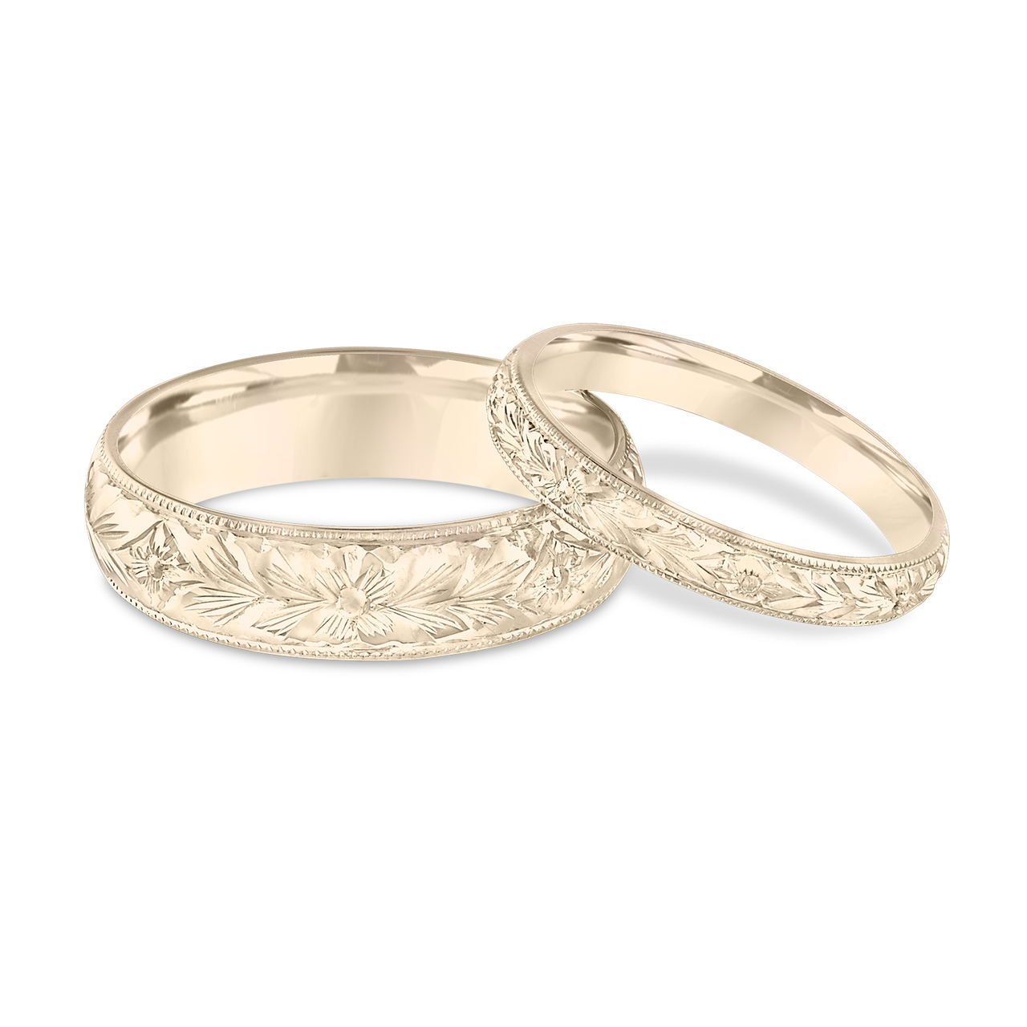
Light Lesson 20 Walking in the Light: Marriage Building Your Dream Home (Part 3)

Slide 3

Introduction
Ephesians 5:8 teaches us, who in the past were in darkness, to walk as children of light.
We want to walk as children of light in our marriages, knowing God will bless us in our obedience.
The eyes of our heart allow us to envision what God wants us to practice in our marriages as we study the scriptures.
So often couples put far more thought into building their dream “house” than they do in building the “dream home.”
If we want to build a dream home, we must do the same things we would do in building our dream house.
Previously, we learned:
Consult the Architect!
Lay a solid foundation!
Follow the Architect’s blueprint for the husband of her dreams
Decorate with the Beautiful Furnishings of Righteousness.
In addition to these things, we must also “implement great home maintenance!”

Slide 4

Introduction
The key to great home maintenance is understanding the needs of our mates.
Peter urged men to live with their wives according to knowledge or in an understanding way:
“You husbands likewise, live with your wives in an understanding way, as with a weaker vessel, since she is a woman; and grant her honor as a fellow heir of the grace of life, so that your prayers may not be hindered” (1 Pet 3:7).
It is our job as husbands (and wives) to be educated on what our spouses need from us and seek to provide those needs.
It is the essence of marital love to do so.

Slide 5
Our Mates Personal Values
“What are my mate’s core values?”
Some of their conflicts are due to not understanding how the other might look at a decision or a situation.
For example, two people contemplate a purchase: One looks at the purchase through the values of accountability or frugality. They may say, “I won’t buy what I can’t pay for right now or can’t afford due to other obligations.” Another looks at the purchase through the value of philanthropy or generosity. Thoughts of accountability and affordability give way to the desire to help or bring joy to another regardless of the cost.
And so, the couple may have a conflict because their value systems conflict.
Who is right? Your wife…of course!
Notes:
We all come into marriage with a set of values that were cultivated in our first homes and then maybe reshaped in our adult lives. A good question for couples to ask themselves is, “What are my mate’s core values?”
Exploring our mate’s core value is important because couples sometimes act out of different value systems. Some of their conflicts are due to not understanding how the other might look at a decision or a situation.
For example, two people contemplate a purchase: One looks at the purchase through the values of accountability or frugality. They may say, “I won’t buy what I can’t pay for right now or can’t afford due to other obligations.” Another looks at the purchase through the value of philanthropy or generosity. Thoughts of accountability and affordability give way to the desire to help or bring joy to another regardless of the cost.
And so, the couple may have a conflict because their value systems conflict. Who is right? Your wife…of course! What is ultimately important is that we respect the value systems of our mates.

Slide 6

Our Mate’s Personality Characteristics
The traditional way of thinking about personality involved four temperaments and their combinations (the melancholy, the choleric, the sanguine, and the phlegmatic).
Others have provided more detailed or refined listings of personality types like the sixteen personality profiles of the Meyer-Briggs Type Indicator.
We sometimes expect our mates to think and act like we do!
Yet they are not our clone. Their personality is different, and we need to know why they act the way they do.
We learn that when they respond differently, it does not indicate they are intending to be offensive.

Slide 7

Our Mate’s “Love Language”
Gary Chapman suggested that each person has a primary and secondary “love language.” In other words, people may define and express emotional love in different ways. Here is his list:
Giving gifts
Spending quality time
Speaking words of affirmation
Engaging in acts of service (devotion)
Physical touching
Chapman’s point was that people often show love in the way they prefer to receive it; however, it may not match the preferences of the one to whom they are showing love.
Do you know which “love language” is most meaningful to your mate?

Slide 8


Our Mate’s Preferred Needs as a Male or Female
Willard Harley, Jr. “His needs, Her needs.”
Husbands
Wives
Sexual fulfillment
Recreational companionship
An attractive spouse
Domestic support
Admiration
Affection
Conversation
Honesty and openness
Financial support
Family commitment

Slide 9

Our Mate’s Preferred Needs as a Male or Female
As husbands, we need to ask, “What are the primary needs of my wife that I need to fulfill?” And the wife should ask the same about her husband.
All of these resources can be helpful to some degree in gaining knowledge or understanding, but none of them will do any good unless we “tune in” to our mate. Observe and pay attention! Ask questions and listen! Make adjustments when you hear expressions of dissatisfaction or neglect or expressions of appreciation and happiness.
One of the ironies of marriage is that we work so hard to know the person we want to marry and to do the things that win them but then often neglect to continue to do those things after marriage.

Slide 10
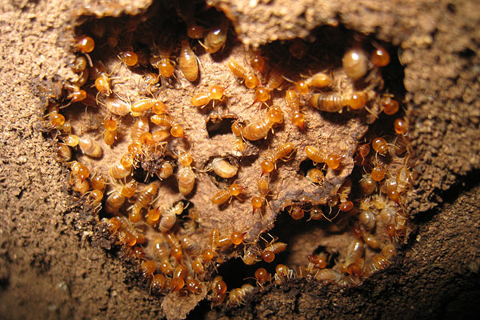
Inspect Regularly for “Termites”!
Anybody who owns a house may have had that disheartening feeling when you recognize termites have undermined the beautiful exterior. And while everything looks great on the outside, underneath termites have been eating away at the structure.
Termites are appropriately called the “silent killers” of your house because when undetected, they can cause major damage.
In the same way, if we want our dream home to stay strong, we need to regularly inspect for those silent marriage wreckers that can almost unobtrusively dismantle our marriage.

Slide 11

Seven Stages of “Termite” Infestation
Gary and Barbara Rosberg “Divorce-Proof Your Marriage”
Disappointment
Discouragement
Distance
Disconnection
Discord
Emotional Divorce
Legal Divorce
Notes:
Seven Stages of “Termite” Infestation
Authors Gary and Barbara Rosberg describe the stages of a wrecked dream home in their book “Divorce-Proof Your Marriage.”
Disappointment
It is the realization the person who you thought was the perfect mate turns out to be not so perfect, rather human actually. It’s the end of the honeymoon period, and reality sets in.
In this first stage, you deal with unmet needs, irritating habits, unanticipated offenses and hurts, and conflicting personalities and values. Disappointment is the first sign that there are problems that need to be overcome, or worse things may develop.
Discouragement
Next comes the feeling of sadness or frustration when problems aren’t being solved. She starts complaining; he gets quiet. And then, there is the thought that the problems can’t be resolved.
Distance
At this point, the couple starts focusing on other things—careers, hobbies, projects, etc. The focus shifts from seeking to please each other to becoming more interested in something else. The couple is growing apart, and communication has broken down.
Disconnection
Now there is a shift in attitude. They once felt hurt because they cared about one another and the relationship. But now, care and concern are abandoned. Why bother? Intimacy is rare.
Discord
By this stage, anger and frustration come to the surface. It becomes easier to criticize and argue; you don’t feel you have much to lose. Things can become hostile as each digs in for conflict and marital warfare.
Emotional divorce
At this stage, one or more of the partners has decided it is over. Emotionally they have already ended the relationship, and it may never go further than this. Maybe there is the embarrassment of failure, the desire to avoid disappointing parents or children who would not approve of divorce. And so, everything has happened except the legal separation of the two.
Legal divorce
Finally, one or more of the partners decides to end it. Surely no one who hears this description wants this to happen. And, it is not inevitable that it happens. You can reverse course and repair the damage already done; your dream home can become good as new.
Do you see signs of termite damage? I hope not! But if so, these are the warnings signs when looking for the source of the damage. It is important we ask, “What are those termites?”

Slide 12

Four Marital “Termites”
INATTENTION
Paul shows that marriage demands paying attention to the needs of our spouse: “but one who is married is concerned about the things of the world, how he may please his wife… but one who is married is concerned about the things of the world, how she may please her husband” (1 Cor 7:33–34).
Notes:
Four Marital “Termites”
Consider four things that can almost silently eat away the foundations of a good marriage.
Inattention
The problem with termites is they don’t make any noise. They are silent destroyers; so is inattention. A husband or wife can be oblivious to their partner’s unhappiness. They assume they will always “be there” for them; or that they have the power with a few moments of attention to draw them back into the relationship.
Inattention usually means our focus is somewhere else, and there are obviously many things that can vie for our attention. These often include the following: work, friends, other family members (children), and hobbies.
In contrast, Paul shows that marriage demands paying attention to the needs of our spouse: “but one who is married is concerned about the things of the world, how he may please his wife… but one who is married is concerned about the things of the world, how she may please her husband” (1 Cor 7:33–34).
Selfishness
Selfishness is probably at the root of all sin, but it is especially problematic in marriage. If we approach a relationship selfishly, we’ll only be concerned about what we want from the relationship.
Marriage cannot succeed with two people selfishly seeking what they want. Instead, it must be a relationship of mutual giving. Paul taught the mutual self-giving nature of marriage. To the men, he said, “For no one ever hated his own flesh, but nourishes and cherishes it, just as Christ also does the church” (Eph 5:29). Likewise, to the women, he said: “that they may encourage the young women to love their husbands, to love their children, to be sensible, pure, workers at home, kind, being subject to their own husbands, that the word of God may not be dishonored” (Titus 2:4–5).
These commands require a selfless serving mentality. “Do nothing from selfishness or empty conceit, but with humility of mind let each of you regard one another as more important than himself” (Phil 2:3).

Slide 13

Four Marital “Termites”
INATTENTION
SELFISHNESS
Marriage must be a relationship of mutual giving.
To the men, he said, “For no one ever hated his own flesh, but nourishes and cherishes it, just as Christ also does the church” (Eph 5:29). Likewise, to the women, he said: “that they may encourage the young women to love their husbands, to love their children, to be sensible, pure, workers at home, kind, being subject to their own husbands, that the word of God may not be dishonored” (Titus 2:4–5).
These commands require a selfless serving mentality. “Do nothing from selfishness or empty conceit, but with humility of mind let each of you regard one another as more important than himself” (Phil 2:3).
Notes:
Selfishness
Selfishness is probably at the root of all sin, but it is especially problematic in marriage. If we approach a relationship selfishly, we’ll only be concerned about what we want from the relationship.
Marriage cannot succeed with two people selfishly seeking what they want. Instead, it must be a relationship of mutual giving. Paul taught the mutual self-giving nature of marriage. To the men, he said, “For no one ever hated his own flesh, but nourishes and cherishes it, just as Christ also does the church” (Eph 5:29). Likewise, to the women, he said: “that they may encourage the young women to love their husbands, to love their children, to be sensible, pure, workers at home, kind, being subject to their own husbands, that the word of God may not be dishonored” (Titus 2:4–5).
These commands require a selfless serving mentality. “Do nothing from selfishness or empty conceit, but with humility of mind let each of you regard one another as more important than himself” (Phil 2:3).

Slide 14
Four Marital “Termites”
INATTENTION
SELFISHNESS
UNFORGIVENESS
When two people live as close as a husband and wife, there are going to be times of neglect or mistreatment. It is during this time our love is tested.
So do we have a love that forgives and forgets? Or do we hold grudges and become bitter? Do we accumulate wrongs?
Paul warned the husbands: “Husbands, love your wives, and do not be embittered against them” (Col 3:19).
Surely the teaching of the Lord applies to marriage as much as in any relationship: “For if you forgive men for their transgressions, your heavenly Father will also forgive you. But if you do not forgive men, then your Father will not forgive your transgressions” (Matt 6:14–15).
“And be kind to one another, tender-hearted, forgiving each other, just as God in Christ also has forgiven you.” (Eph 4:32).
Notes:
Unforgiveness
When two people live as close as a husband and wife, there are going to be times of neglect or mistreatment. It is during this time our love is tested. So do we have a love that forgives and forgets? Or do we hold grudges and become bitter? Do we accumulate wrongs? Paul warned the husbands: “Husbands, love your wives, and do not be embittered against them” (Col 3:19).
Surely the teaching of the Lord applies to marriage as much as in any relationship: “For if you forgive men for their transgressions, your heavenly Father will also forgive you. But if you do not forgive men, then your Father will not forgive your transgressions” (Matt 6:14–15).
Instead, we need to live out Paul’s exhortation: “And be kind to one another, tender-hearted, forgiving each other, just as God in Christ also has forgiven you.” (Eph 4:32).

Slide 15

Four Marital “Termites”
INATTENTION
SELFISHNESS
UNFORGIVENESS
DISLOYALTY
Marriage requires an exclusive loyalty of a man and woman to one another. “For this cause a man shall leave his father and his mother, and shall cleave to his wife; and they shall become one flesh” (Gen 2:24).
Both partners must have an absolute commitment to the unity of their relationship, avoiding any effort to build a “marriage-like” relationship with another person.
Couples must keep proper boundaries with close associates.
One especially pernicious form of disloyalty is pornography. In it, a man or woman substitutes the proper desire and attraction for their mate to someone else. We should reflect soberly on the words of Jesus. “But I say to you, that everyone who looks on a woman to lust for her has committed adultery with her already in his heart” (Matt 5:28).
Notes:
Disloyalty
Marriage requires an exclusive loyalty of a man and woman to one another. “For this cause a man shall leave his father and his mother, and shall cleave to his wife; and they shall become one flesh” (Gen 2:24).
Both partners must have an absolute commitment to the unity of their relationship, avoiding any effort to build a “marriage-like” relationship with another person. By focusing on another man or another woman, we erode our interest in the person on whom we should be focusing. We may have compared one person with another as a prospective mate, but that must now come to an end. Do not allow yourself to imagine what life would have been like with someone else.
When a man begins to focus on another woman or a woman begins to focus on another man their loyalty to one another is eroded, and the other’s security and trust is undermined. That is why couples must keep proper boundaries with close associates.
One especially pernicious form of disloyalty is pornography. In it, a man or woman substitutes the proper desire and attraction for their mate to someone else. We should reflect soberly on the words of Jesus. “But I say to you, that everyone who looks on a woman to lust for her has committed adultery with her already in his heart” (Matt 5:28).

Slide 16
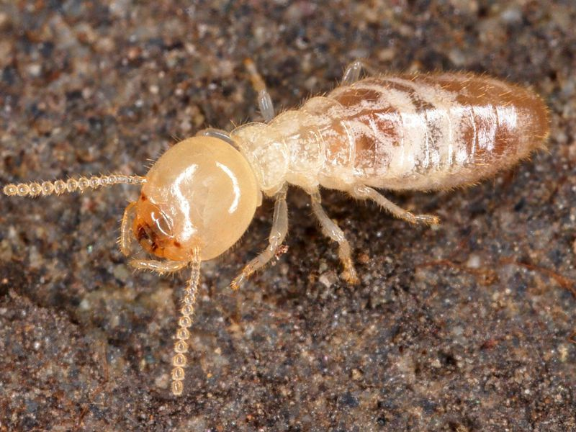
Four Marital “Termites”
INATTENTION
SELFISHNESS
UNFORGIVENESS
DISLOYALTY

Slide 17

Conclusion
All these things are marital termites that can silently wreck our homes. A person would be foolish indeed not to be on the alert for the things that would undermine the foundations and structure of their houses. And the same could be said about those who ignore the reality of “termites” in their relationship.
Instead, let’s do inspections regularly. Stay attentive! Continue to do the things that you once did to win your partner’s love. Approach your marriage with a servant’s heart thinking, “How can I make the life of my mate better?” Deal with the things that make you angry, and seek forgiveness and reconciliation. Do not allow another person to distract you from the loyal love your mate deserves. When we implement these principles, we can preserve our dream homes!

Slide 18

Conclusion
As children of light envisioning our dream homes, let us build on the solid foundation that God has planned.
We must put faith in God in our marriages and follow God’s plan.
The real key to a happy marriage is a righteous marriage – or more properly, the union and interaction of two righteous people who want to please God.
When we create a culture of righteousness in our homes, we prepare the way for a true dream home!
Your home will be a thing of amazing beauty as you walk in the light in your marriage.

